Slide 1
Statistical analysis of groundwater contaminants at Hidalgo county using Python’s matplotlib
Dwight Zedric Q. Capus

Slide 2
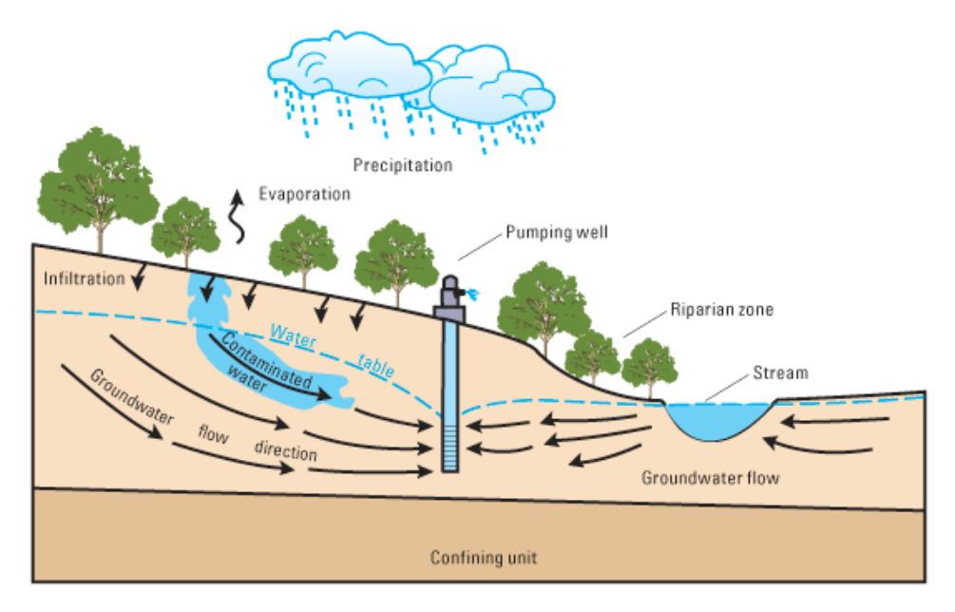
Background
-Texas major source of water (60%)

Slide 3
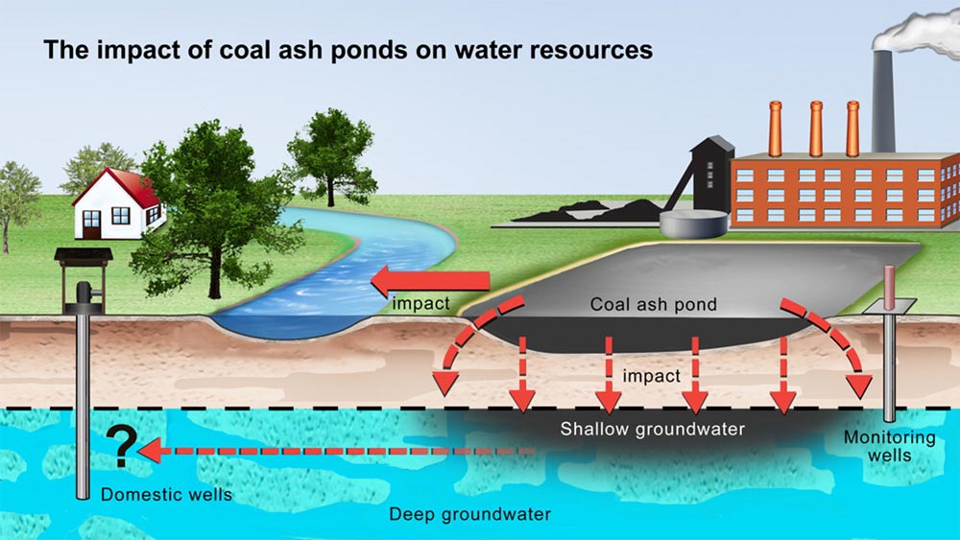
Background
-Texas major source of water (60%)
Groundwater contamination is generally defined as any harmful alteration of the naturally occurring quality of groundwater (Gangwar et al., 2021).
Research focuses on anthropogenic contamination
https://undark.org/2016/07/13/quarreling-coal-ash-disposal-contamination/

Slide 4
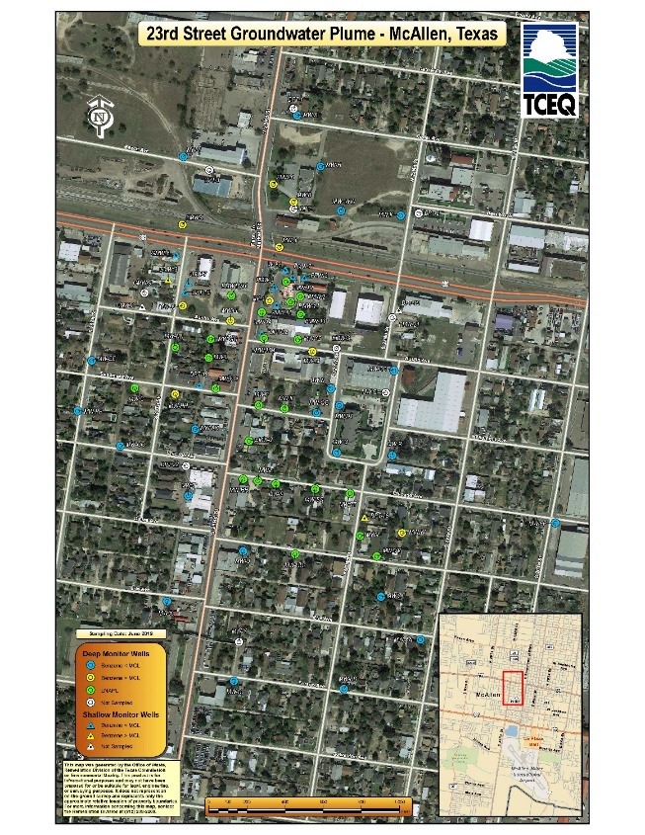
Research objectives
Spatially
Temporally

Slide 5
Methods
Compile data at Excel worksheet
Load necessary packages to jupyterlab
Upload data as dataframe
Subset necessary columns
Plot a time series data of cases and types of contaminants
Plot bar chart.
Create a map with plots of contaminants

